Slide 1
1. User A DISCLOSED OTHERS USER Credit Card INFO (idor) 2. How we make fake transaction receipT

Slide 2
IDOR (Insecure direct object reference)
Example
If Win Sam login as Win Sam and able to Weng Sum Credit Card Information, is this okay?
How to perform ?
[ Original ] www.deloitte.com?Creditcard=xxxxxxxxxx4332
[ Tampered ] www.deloitte.com?Creditcard=xxxxxxxxxx9604

Slide 3
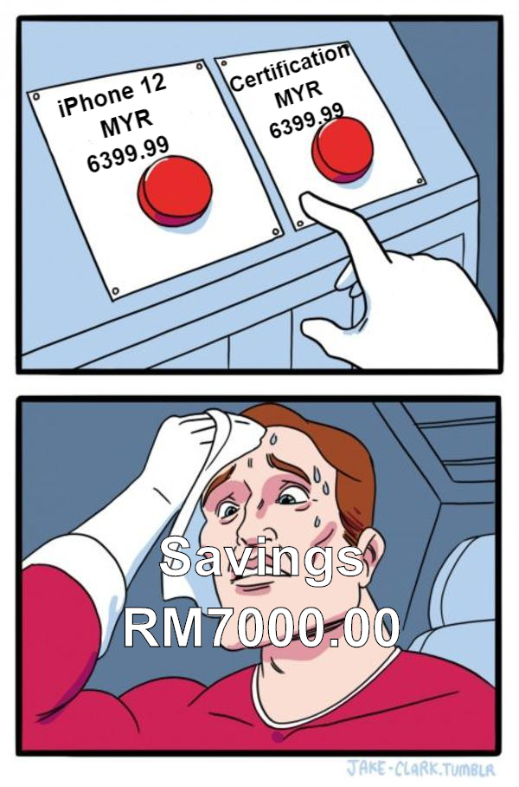

Slide 5
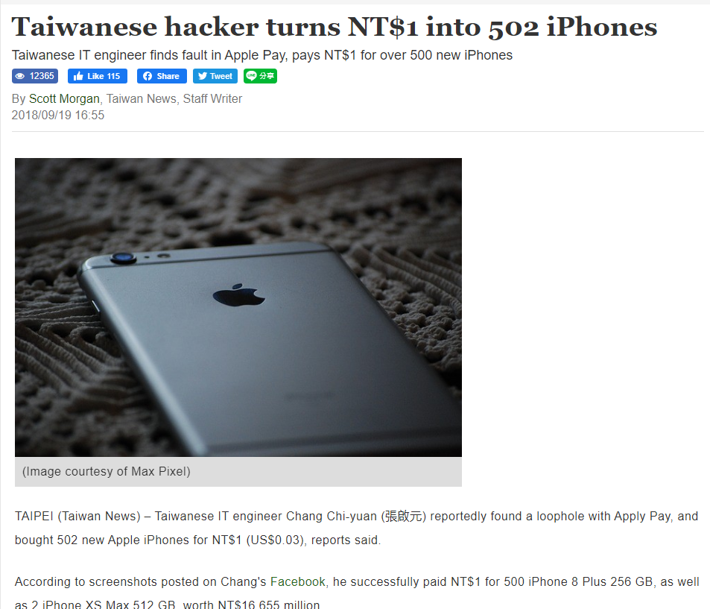

Slide 6



Counter
Token
Payment Gateway

Slide 7
Scenario A | Normal Transaction
Savings
500.00
100.00
Items
1.Token A
2.iCloud
Hi, I want to make MYR 400 for iCloud to Apple Inc
Token A | MYR 400.00
Hi, here is the Token A. Give me the receipt of MYR 400.00 and iCloud Subscription

Slide 8
Scenario B | Fake Transaction
Savings
7000.00
6999.00
Items
1)Token A
2)TokenB
3)iPhone
4)TokenC
5)PS5
Hi, I want to make 1.00 for FUN
Token A | MYR 1.00
I don’t want to proceed the transaction
6998.00
Hi, here is the Token A. Give me the receipt of MYR 6000.00 and iPhone
Hi, I want to make MYR 6000 for iPhone
Token B | MYR 6000.00
Hi, here is the Token A. Give me the receipt of MYR 2500.00 and PS5
Hi, I want to make MYR 2500 for PS5
Token C | MYR 2500.00

Slide 9



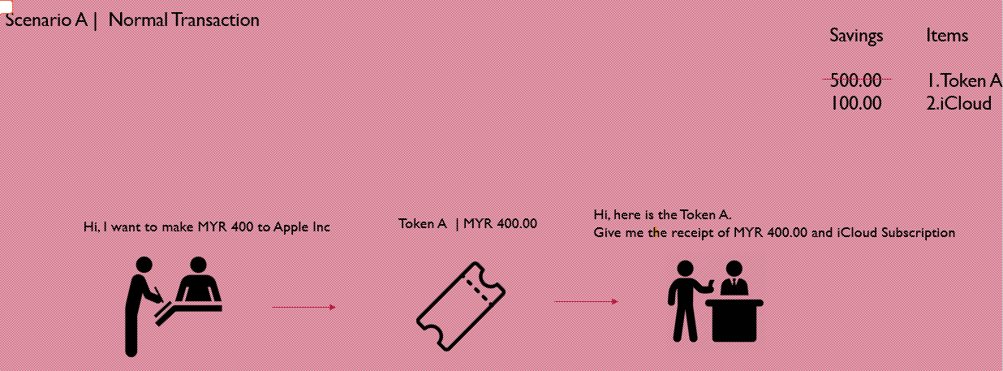
Scenario A
I love you
Me
Crush

Slide 10

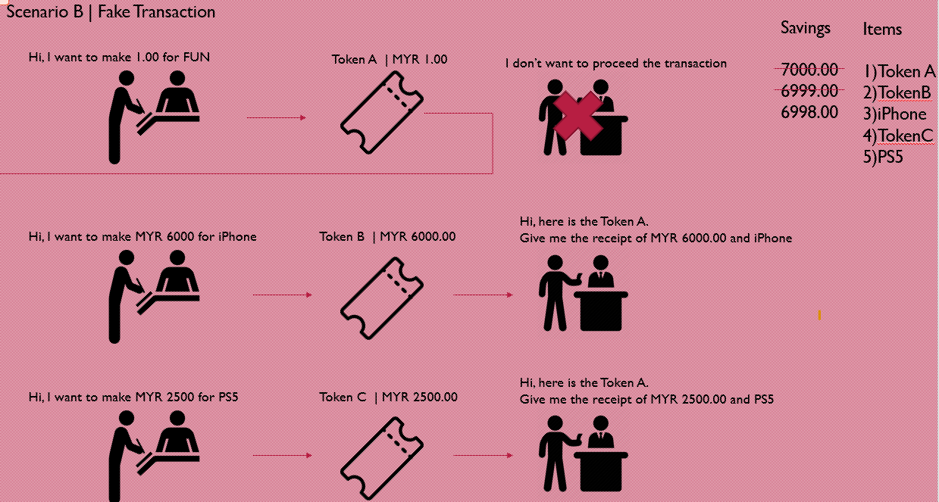
Scenario B
Ask POSTMAN/FRIEND to deliver my letter
I love you
I hate you
Me
Postman
Crush

Slide 11



Scenario B
I love you
I hate you
Me
Postman
Crush
Submit form
Token A
Submit form
Token B
Google Chrome
Proxy/ Burp Suite
Web Server

